Slide 1
Mule Barn Brewing Co.
Welcome to
Bringing locally brewed beer to central Missouri
June, 2023
Prepared for MBBC by Brighter Brew

Slide 2
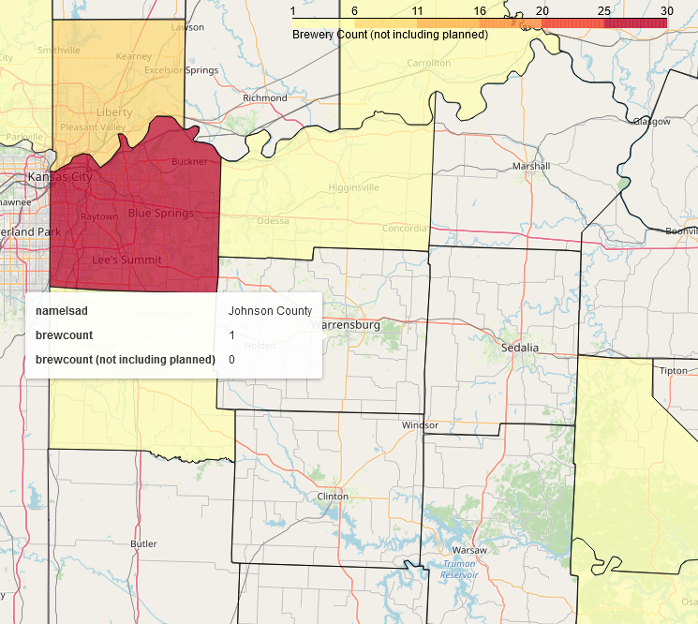
Problem
Click Map to interact
There is a gap in the market for craft beer in the area of Johnson County, MO
There are no operating craft breweries, brewpubs, or tap rooms in Johnson County
There are also no breweries operating in 3 of the 5 bordering counties
* The brewery in Lafayette Co. to the north of Johnson Co. has not produced since 2019

Slide 3
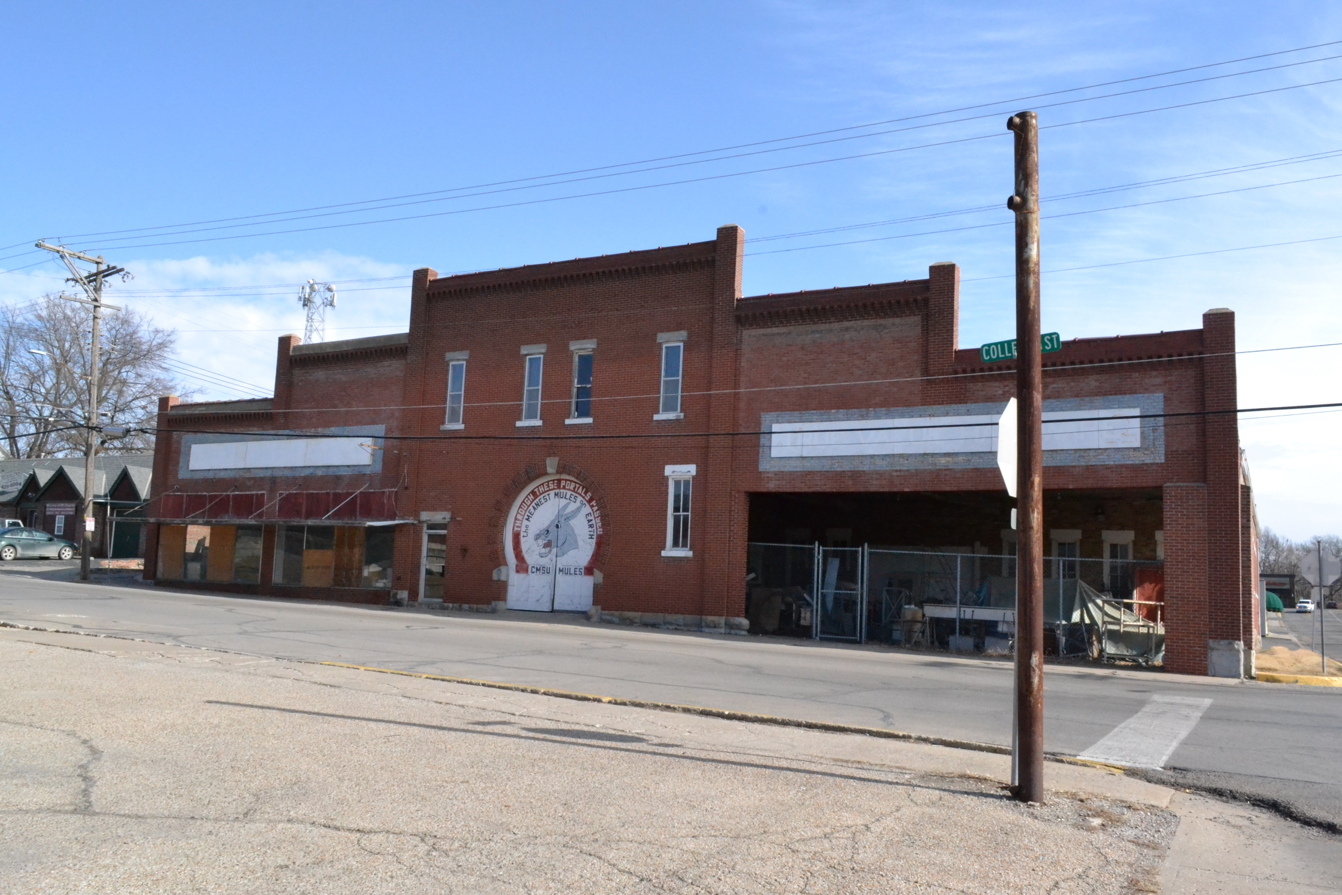
Solution – Mule Barn Brewing Co.
Bring locally brewed craft beer to the area by building a brewery in the iconic Mule Barn on College Avenue in historic Downtown Warrensburg

Slide 4
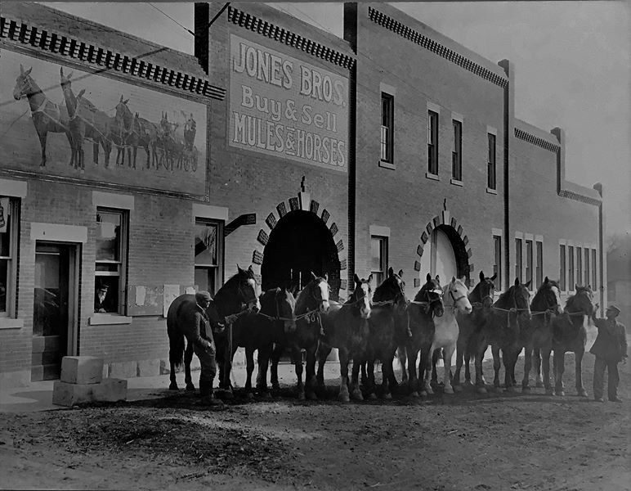
More on the Mule Barn
The Mule Barn was built in 1912 as a mule sales barn
It became a hardware store in the 1930s
The hardware store closed in the early 2000s and the building has since been vacant
The building was added to the National Register of Historic Places in 2010
According to historicmissouri.org, the building is “probably one of the most widely known in Central Missouri”

Slide 5
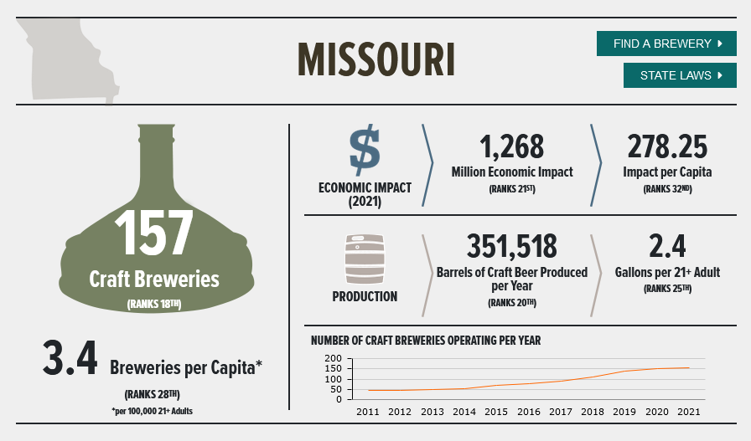
Market Research
Missouri in the US Craft Beer Market
Missouri is overall under-indexed in terms of:
the number of breweries per adult (28th)
the per capita economic impact of the beer business (32nd)
volume produced per adult in the state (25th)
Credit: Brewers Association

Slide 6
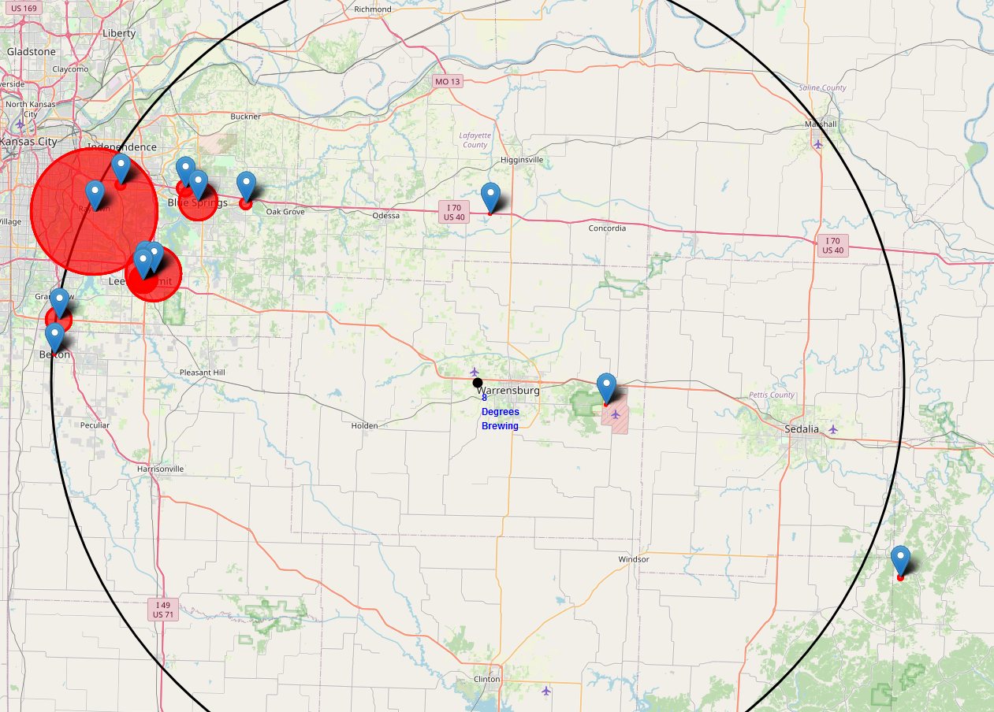
Market Research
Local Craft Beer Market
Click Map to interact
There are no breweries in Johnson Co. or most of its neighboring counties in exurban Kansas City
The nearest concentration of breweries is in metro KC
The closest operating brewery otherwise is Welpman Springs, a micro taproom over 40 miles to the SE. They produced 32 bbls in 2021

Slide 7
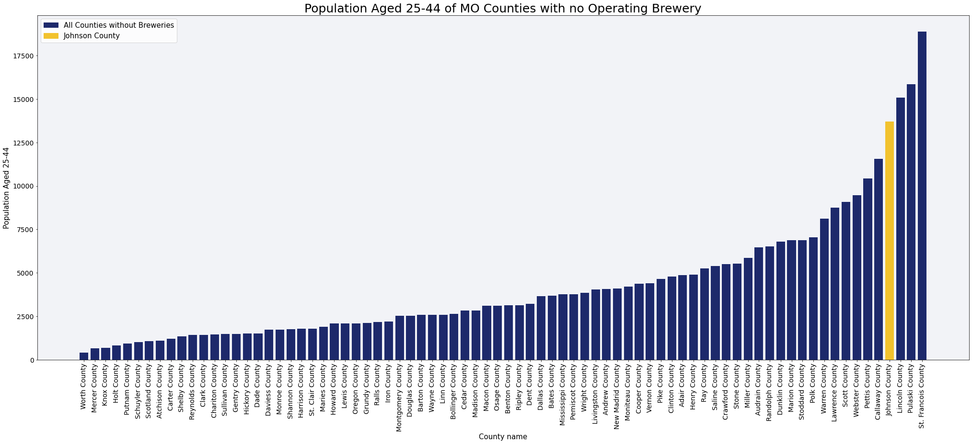
Market Research
Size of the Market
Of all counties in Missouri without a local brewery, Johnson Co. has the 4th highest population in the key demographic of 25–44-year-olds

Slide 8
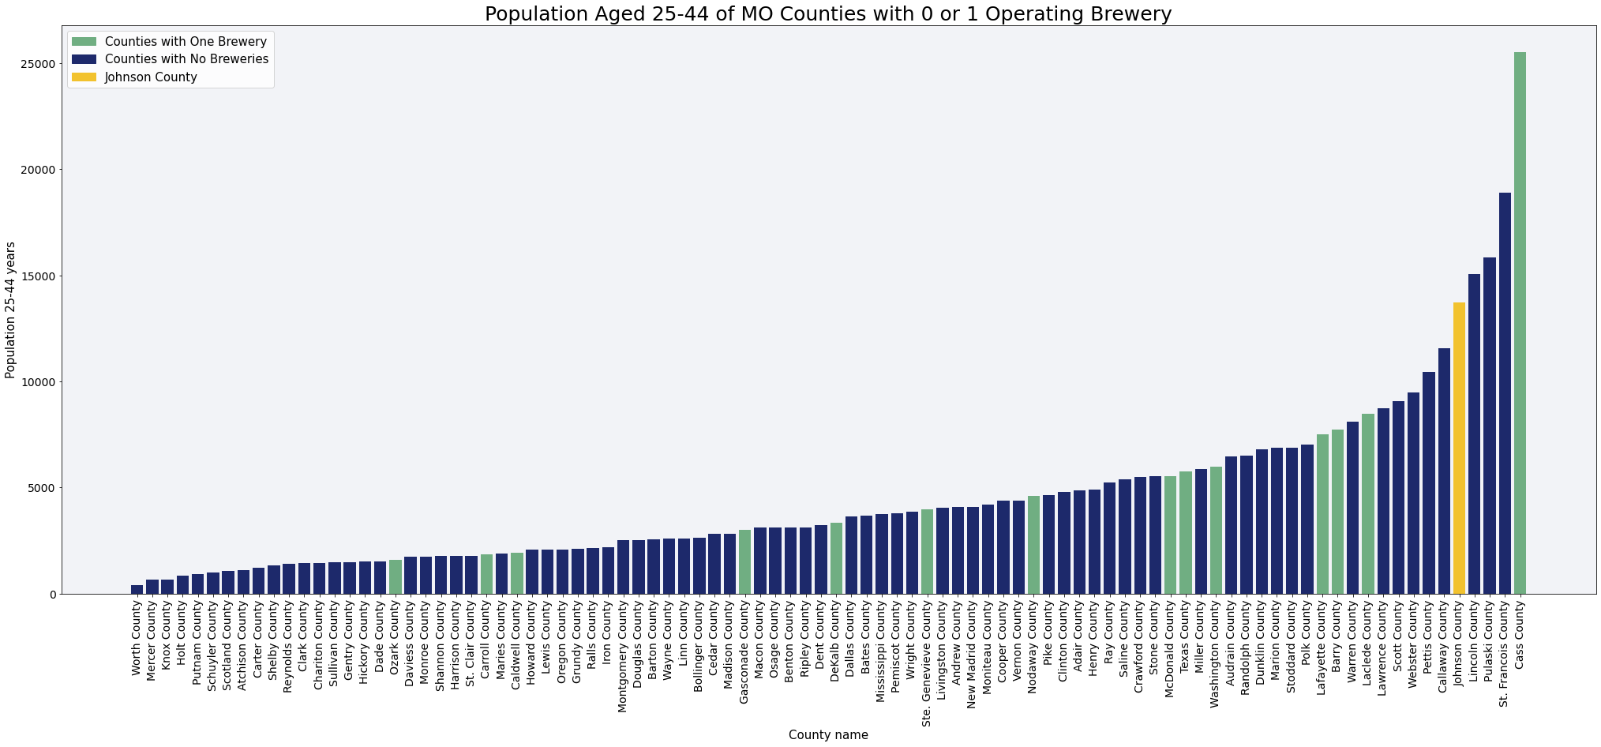
Market Research
Size of the Market
Johnson Co. also has a larger population 25-44 of all counties but one (Cass Co.) with a single local brewery

Slide 9
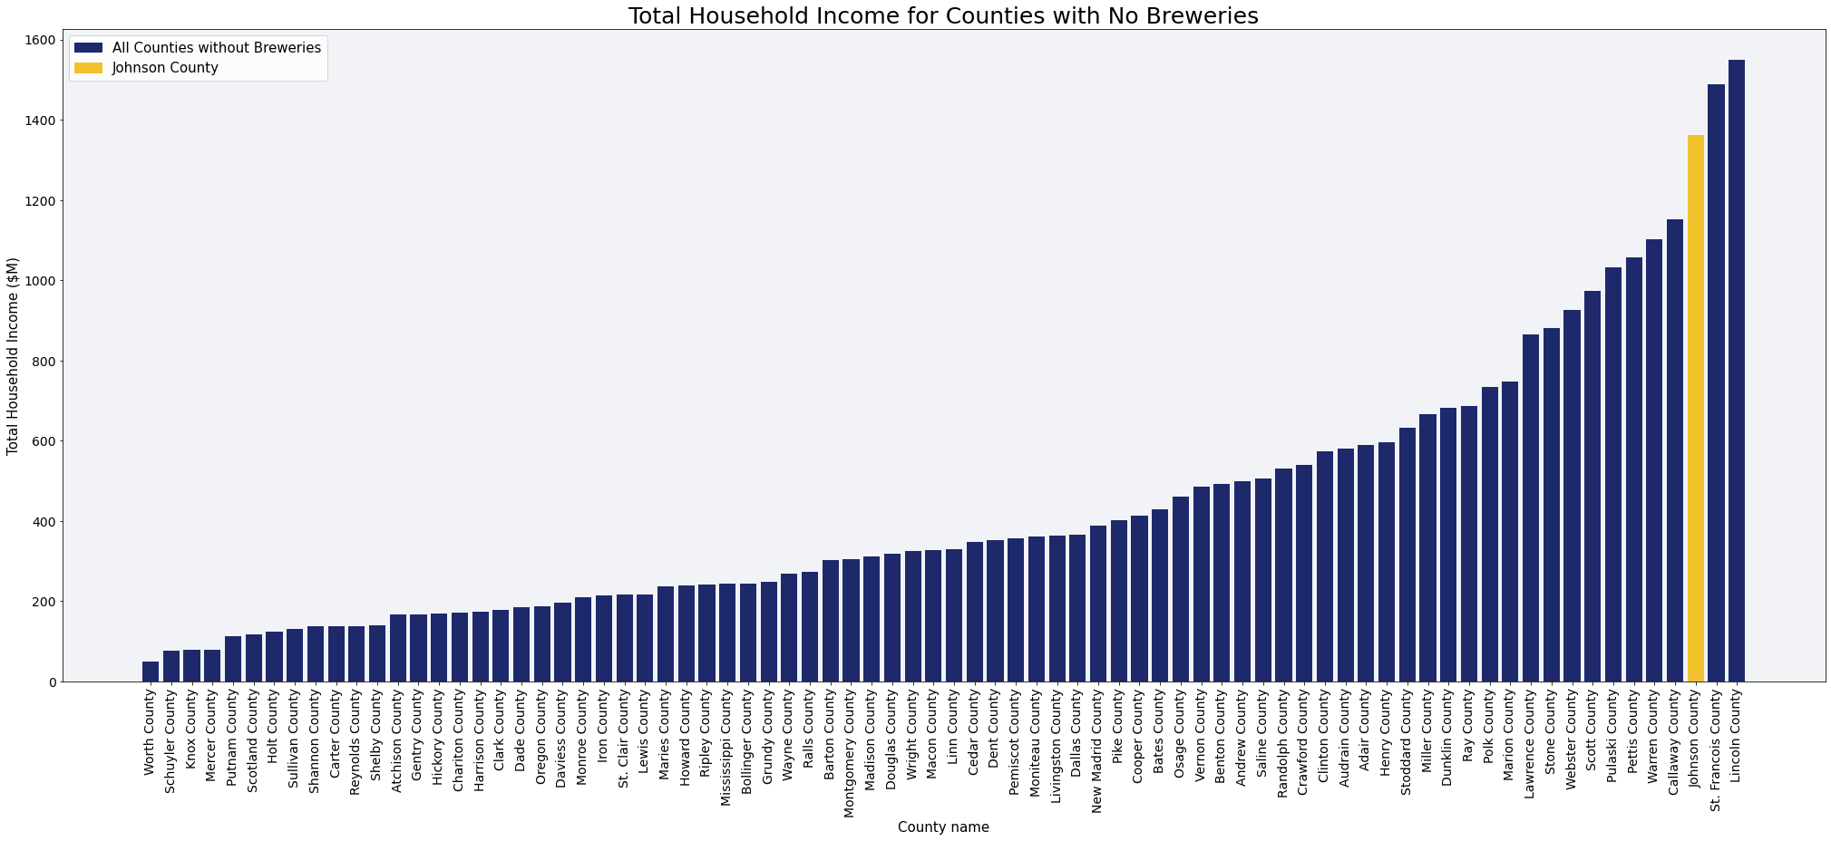
Market Research
Size of the Market
Additionally, Johnson Co. has the 3rd largest household economy of all MO counties without a local brewery

Slide 10
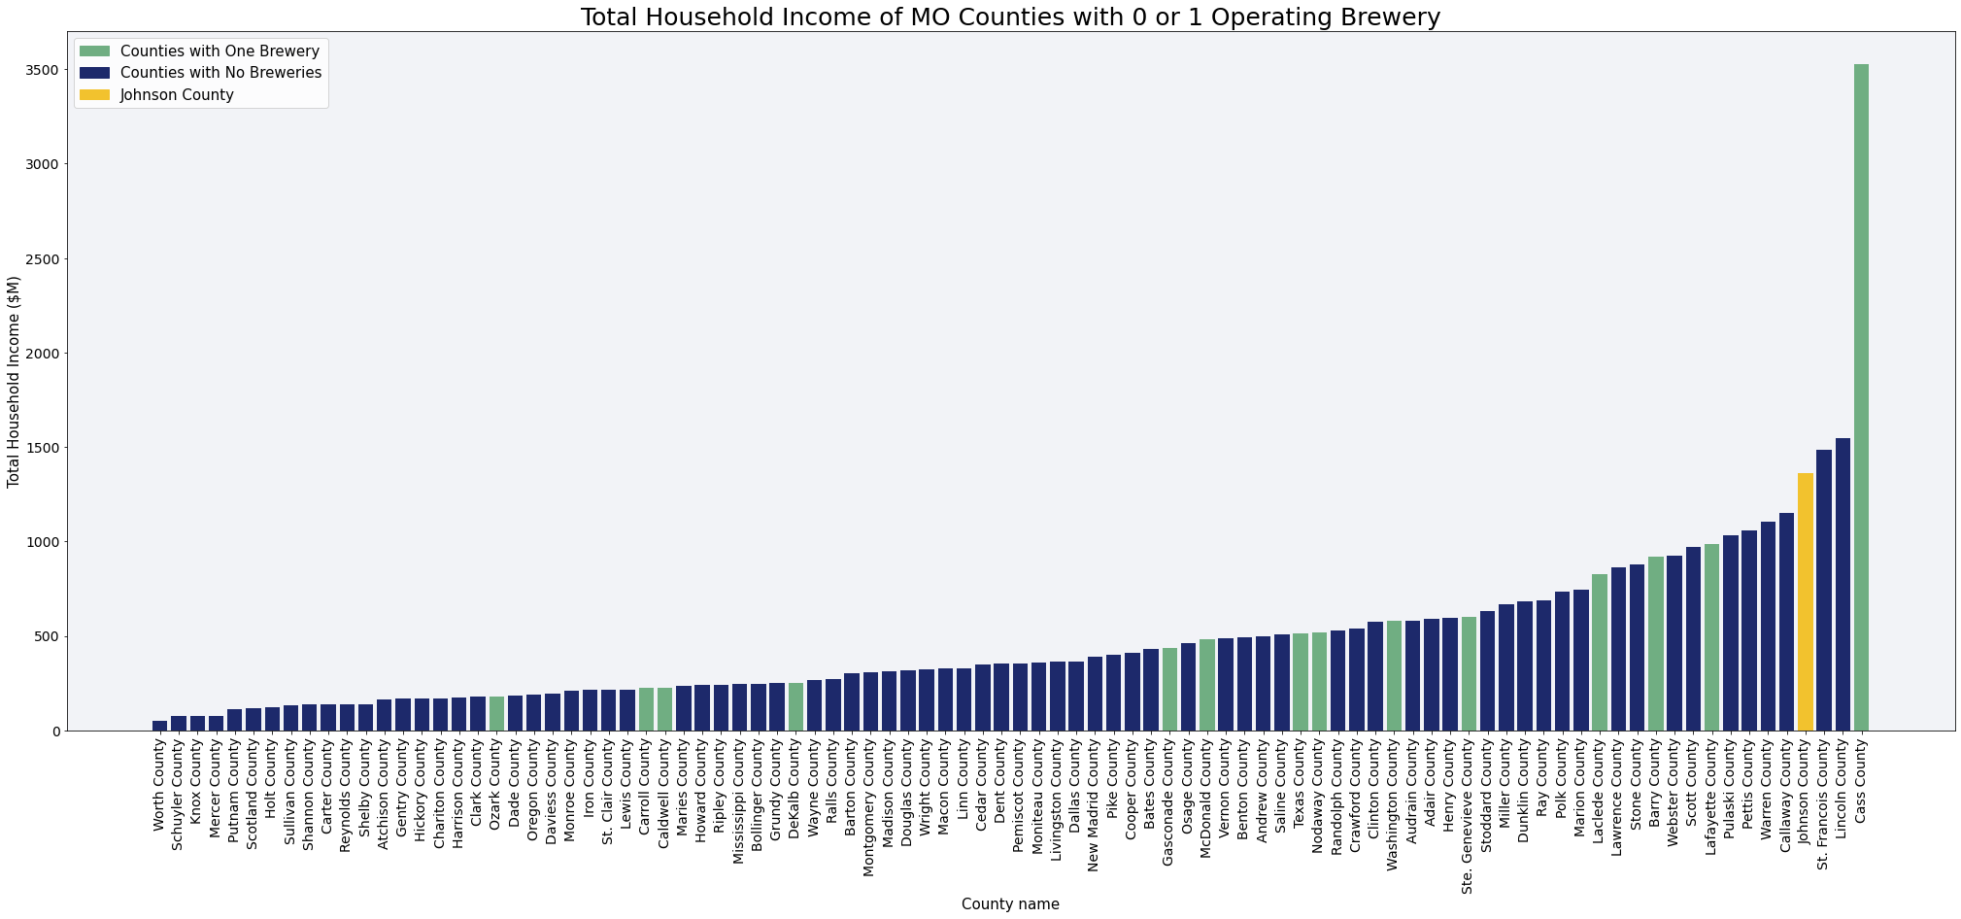
Market Research
Size of the Market
Like in the population data, among counties with a single local brewery, only Cass Co. has a larger economy than Johnson Co.

Slide 11
Market Research – Further Reading
For further reading on local market research, including dozens of interactive maps, charts, and machine learning predictions of the size of the local beer market, please request access to the 34-page original market research report by Brighter Brew

Slide 12
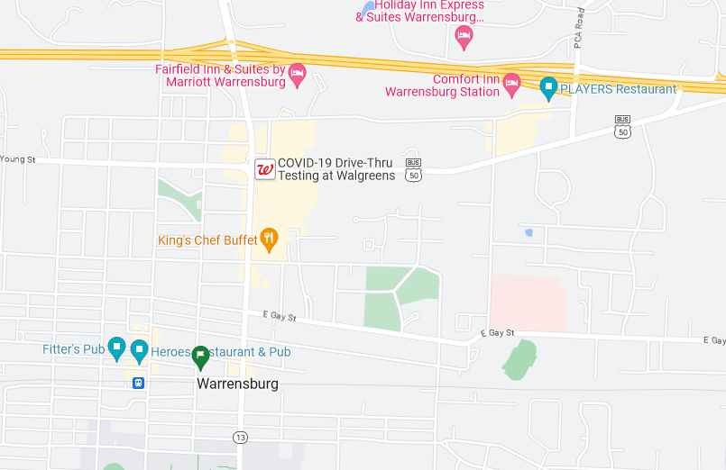
Competition
There are three local pubs with a moderate focus on craft beer
Fitter’s Pub has several craft beers on tap and a cooler with national and local craft for takeout
Heroes Pub serves mostly domestic and some craft beer
Players Restaurant also serves mostly domestic and some craft beer
All three establishments have expressed an interest in serving MBBC products
MMBC

Slide 13
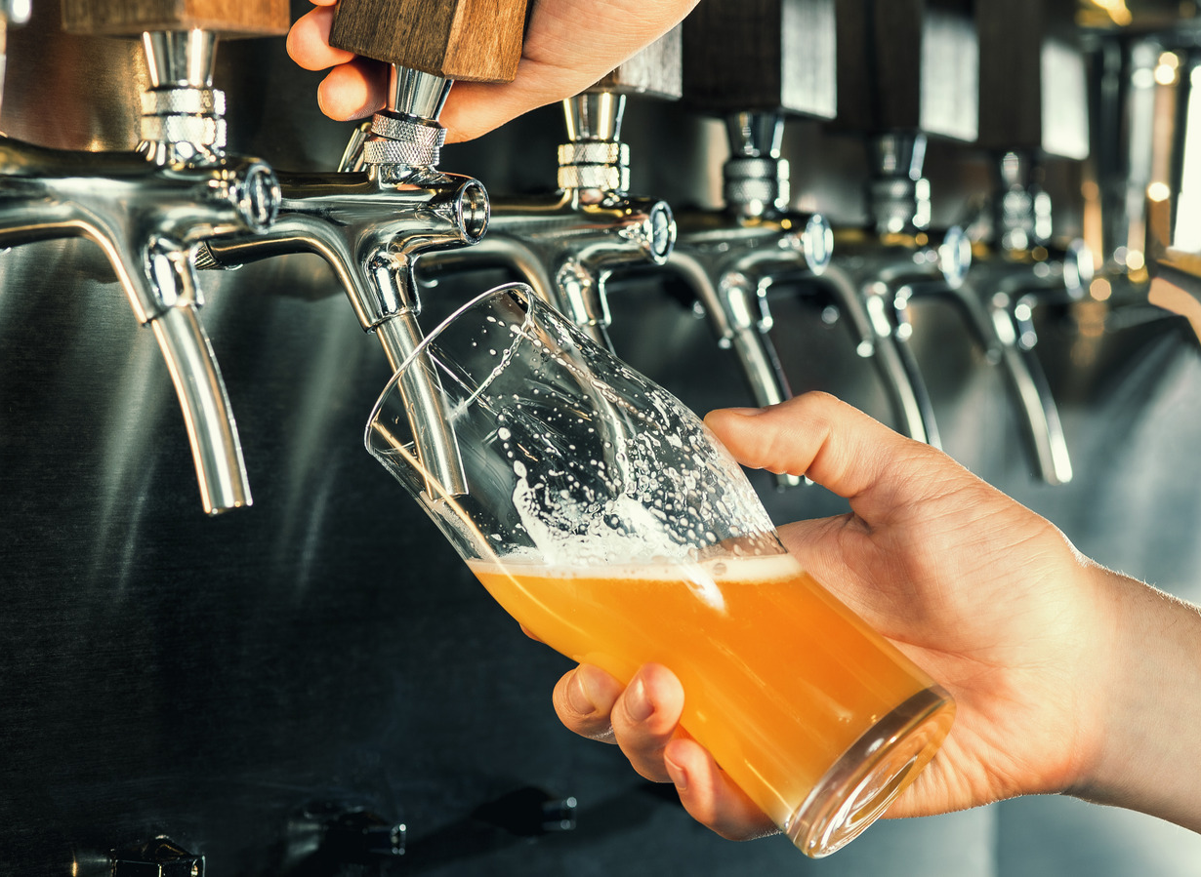
Competitive Advantages
Will be the only taproom serving locally-on-site brewed beer within a wide area
Competing pubs are excited to serve MBBC’s products and therefore to promote the brewery
Opportunity to be exclusive local beer partner for local events and non-aligned businesses

Slide 14
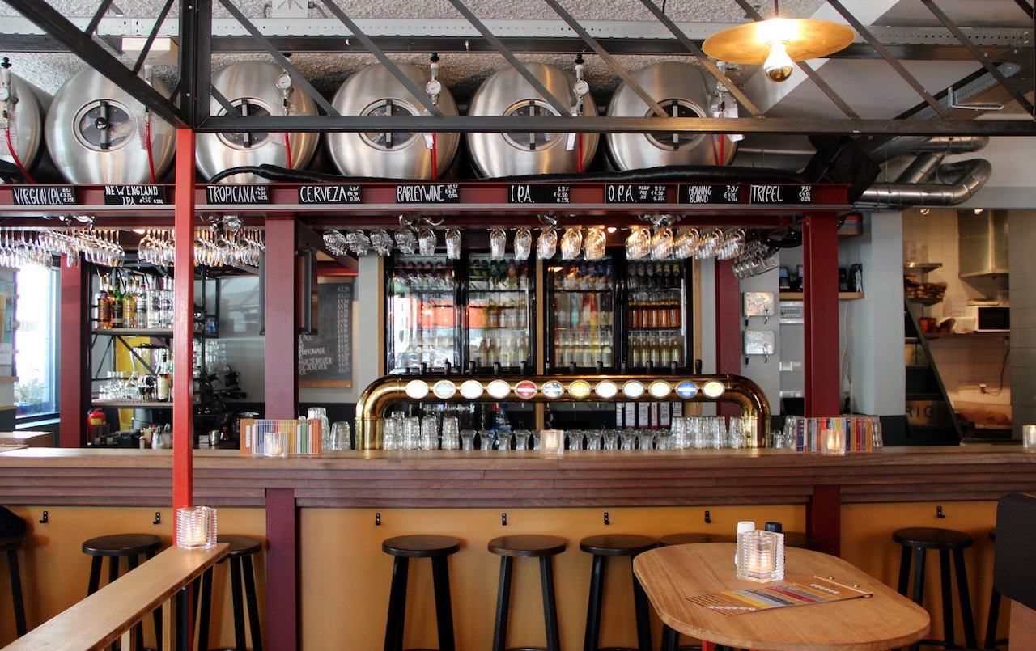
Business Model
MBBC will operate under the brewpub model, and over 90% of revenue will come from direct-to-consumer retail sales of:
Locally-on-site brewed craft beer
Simple food offerings
Crafted batch cocktails
Branded merchandise
To-go sales of locally brewed beer

Slide 15
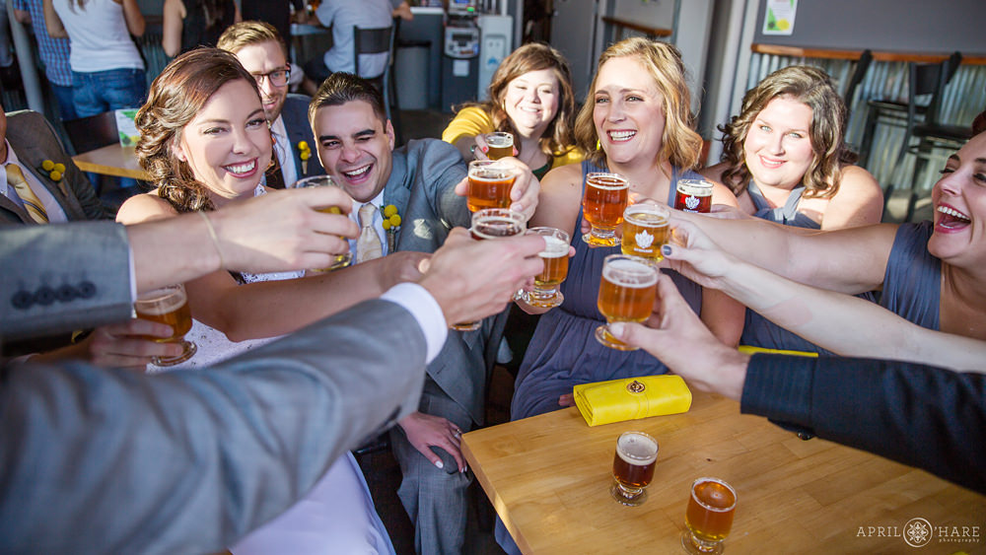
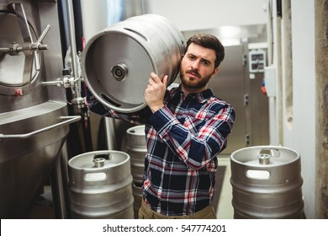
Business Model
Secondary revenue sources include:
Event rentals, both a dedicated space above the retail space, and rental of the main retail space under certain circumstances
Limited self-distribution, legal under MO law, to on-premise establishments in the local area

Slide 16
Go-to-Market Timeline
Acquisition of Funding
Renovation
Hiring
Outfitting and Branding
Equipment Installation & Testing
Furnishing and Final Prep
Initial Production
Soft Open
Public Open
Training
6 months
3 months
1 month
2 months

Slide 17
Financial Projection - Summary
Project high six-figure revenue, growing to over $1 million by year 5
Total COGS including materials and direct labor in the mid-40% range
Achieve 15% EBITDA margin benchmark by year 5
Conservative Projections anticipate investor payback by 5th year

Slide 18
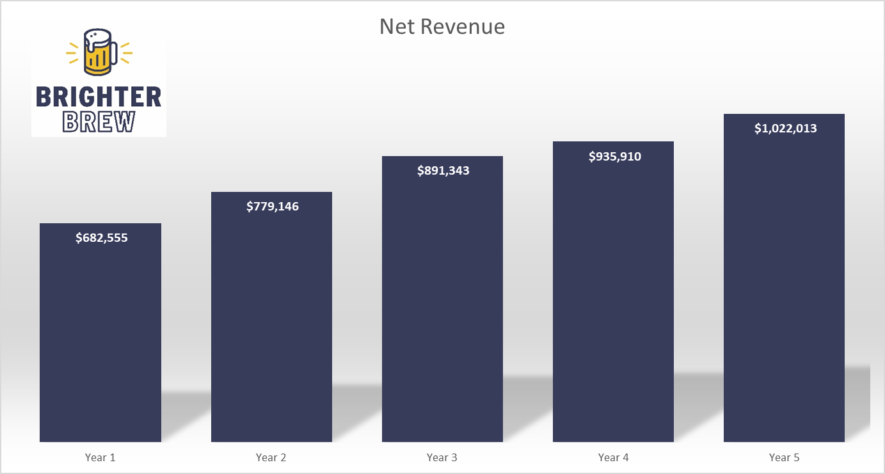
Net Revenue
Assuming modest YoY growth between 5-15%

Slide 19
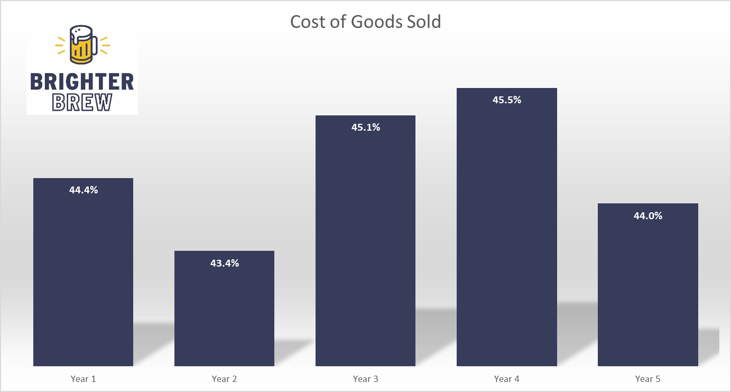
COGS

Slide 20
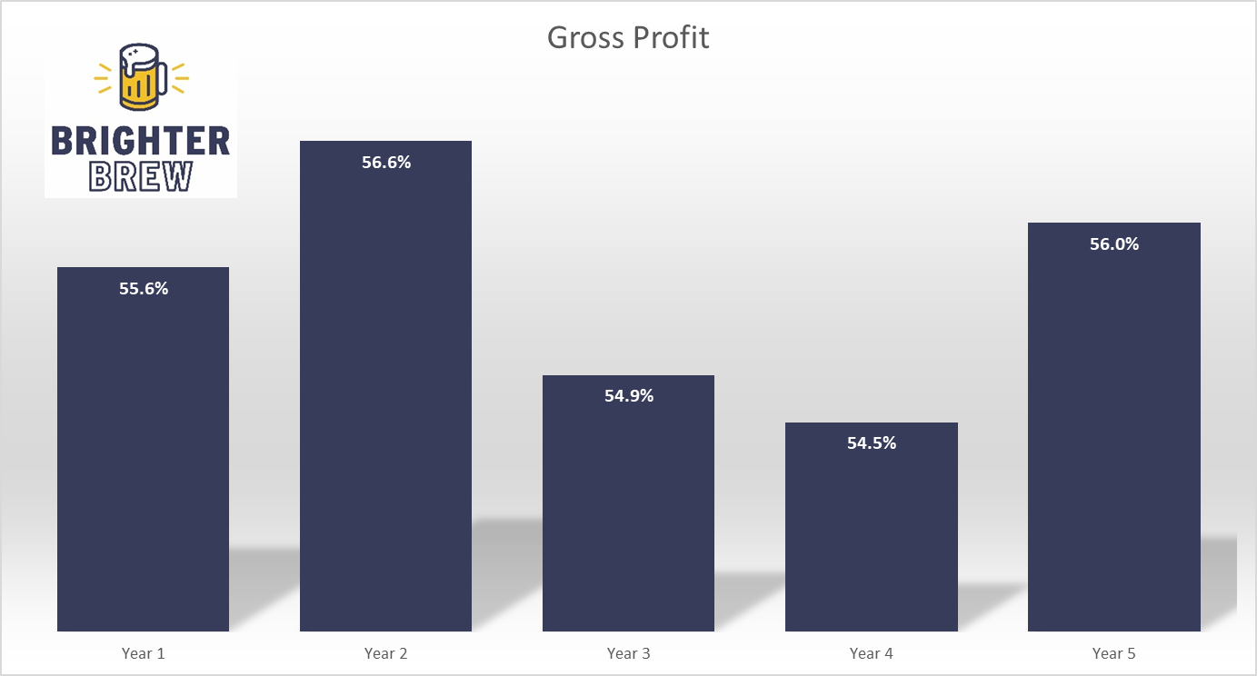
Gross Profit

Slide 21
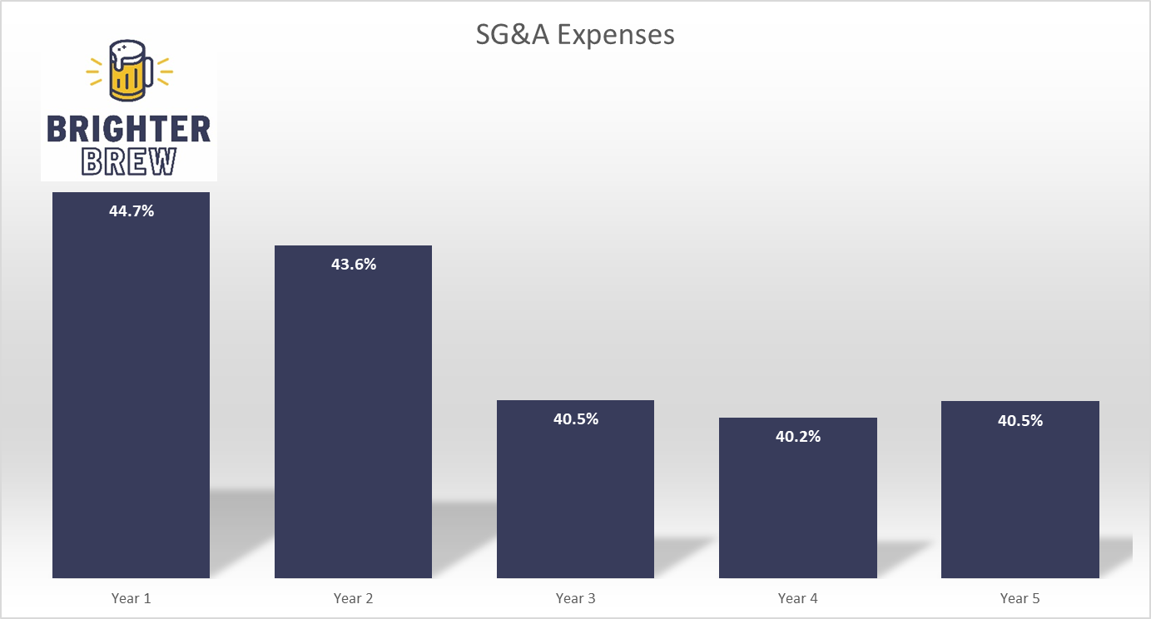
SG&A

Slide 22
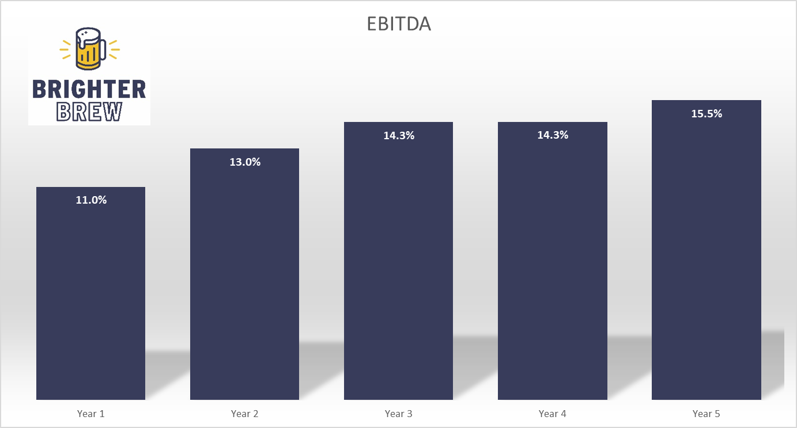
EBITDA Margin

Slide 23
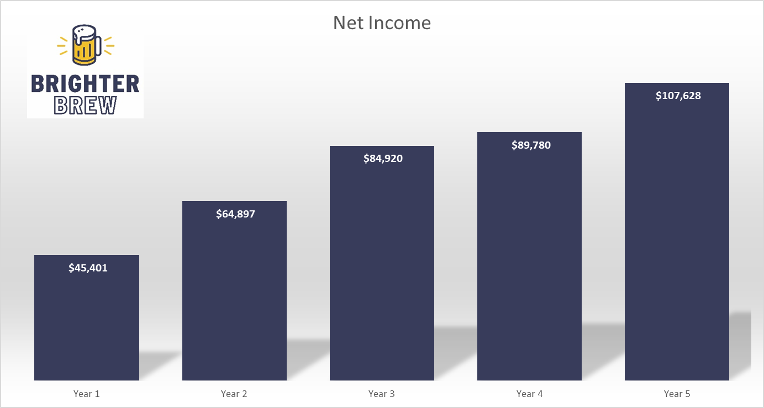
Net Income

Slide 24
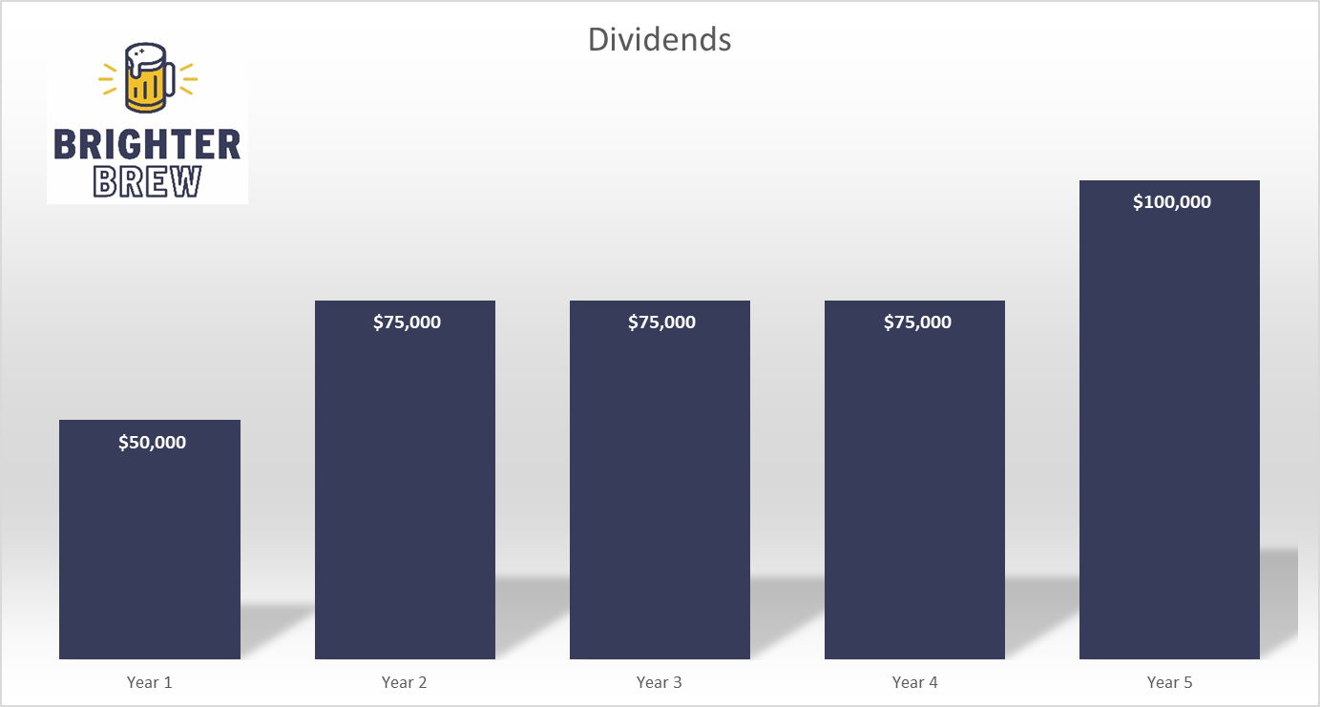
Dividends

Slide 25
Start-up Capital and Expenses

Slide 26
Share Offering
$300k needed for seed funding
12 shares offered at $25k each
Represent a total 50% ownership
No further funding rounds anticipating barring future expansion
Equity shareholders to be paid back in entirety prior to any distribution to non-equity shareholders
Contact Andy Weldon with inquiries
8degreesbrewing@gmail.com
(660) 563-1590
Contact Aaron Weaver at Brighter Brew for more information
aaron@brighterbrew.com
(770) 843-5712

Slide 27
Financing Needed
Seeking $300k in financing to cover seed capital and start-up expenses

